Slide 1







Node JS
INTRODUCTION

Slide 2



Node.js is an open-source, cross-platform, JavaScript runtime environment
that executes JavaScript code outside of a browser. (From Wikipedia)
HARD TO UNDERSTAND RIGHT?

Slide 3



A PLATFORM
which allows us to run JAVASCRIPT
on a computer/server

Slide 4


Install NODE JS

Slide 5
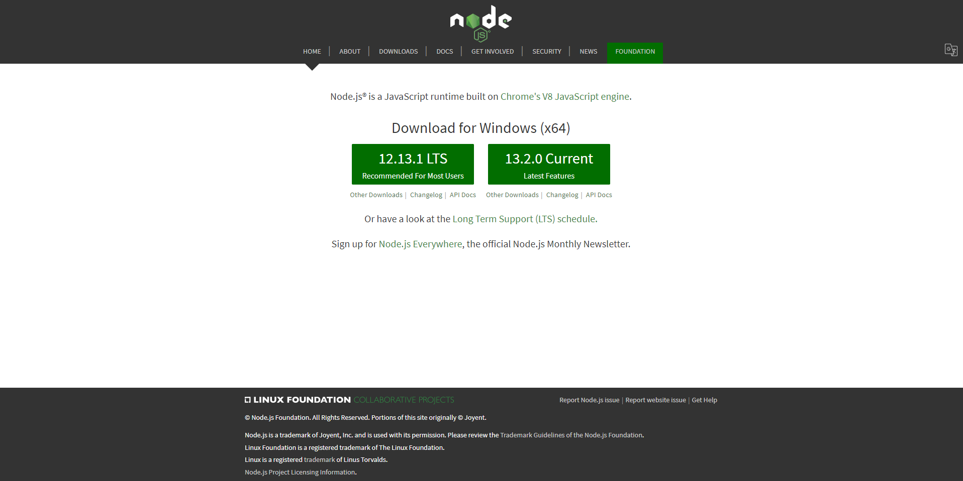


Go to node website https://nodejs.org/en/

Slide 6


Now open command promt and write `node -v`
then you'll see
what version use are using
of node.

Slide 7

create a folder and name it
whatever you want

Slide 8

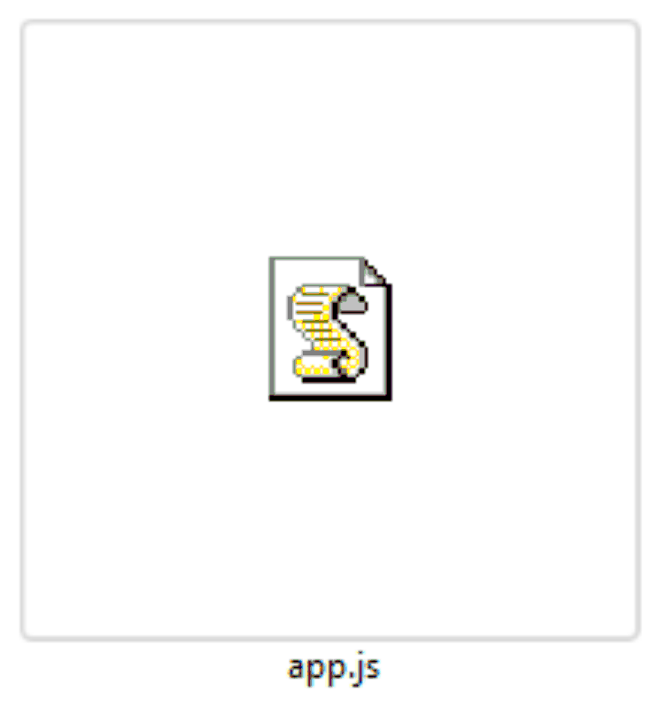



create a ﬁle
and name it whatever you want with .js extention

Slide 9

Open command promt on this folder
and write command
`node YOURFILENAME` like `node app.js`

Slide 10
AND MAGIC!!! SEE THE RESULT!
So did you installed it properly?

Slide 11

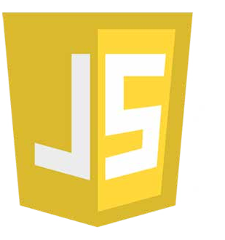

JAVASCRIPT
Engine

Slide 12



WHY WE NEED JAVASCRIPT ENGINE ?
Because computer is not smart enough to understand javascript without javascript engine.
So, Javascript engine work as a middle man to make computer understand the javascript.

Slide 13

SO WHAT IS THE PURPOSE OF JAVASCRIPT ENGINE ?
Make the javascript codes into machine/binary codes.

Slide 14
SOME JAVASCRIPT ENGINES
V8 by Google for Chrome(most used) SpiderMonkey by Mozila for Firexof JavascriptCore by Apple for Safari
Chakra by Microsoft for Microsoft Edge
Hemes engine by Facebook for Android apps

Slide 15


WHAT IS V8 ?
V8 is an open-source JavaScript engine developed by The Chromium Project for Google Chrome and Chromium web browsers.
The project’s creator is Lars Bak.
The ﬁrst version of the V8 engine was
released at the same time as the ﬁrst version of Chrome: September 2, 2008. (wikipedia)

Slide 16


SO HOW V8 WORKS?
We write codes It goes to v8
Finally v8 changes it to c++
c++ changed into machine codes

Slide 17
ARE YOU FEELING TIRED AFTER ALL THESE INFORMATION ?
One tricky question for you then,
if every company can make their own version of engine then they should not make it in their way right ?
Why same javascript codes works on all browser in a same way ?

Slide 18


TIRED OF SEARCHING ANWSER ?

Slide 19


Because everyone follow 'ECMAScript'. This is standardized for writing JavaScript engine!

Slide 20


Function Declarations
Function
Expressions

Slide 21
Function Declarations are normal function we write!

Slide 22
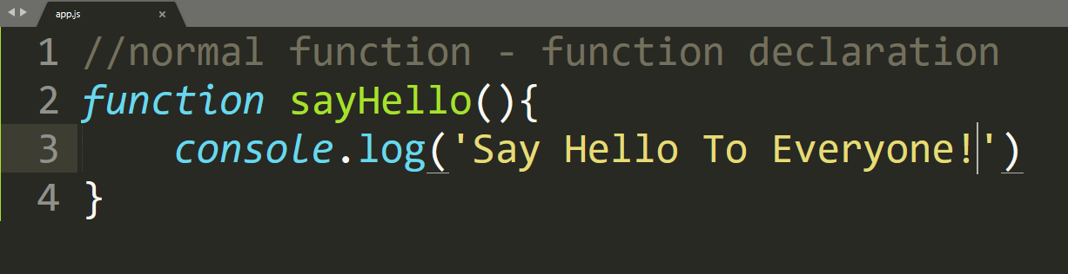
Example (FUNCTION DECLARATIONS)

Slide 23
FUNCTION EXPRESSIONS
The function keyword can be used to deﬁne a function inside
an expression. [MDN]

Slide 24


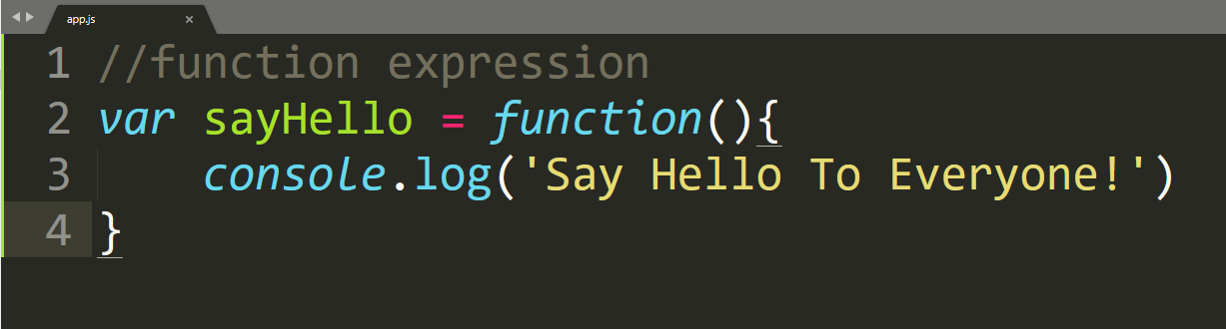
Example (FUNCTION EXPRESSIONS)

Slide 25
Why this is IMPORTANT ?

Slide 26

Because this pattern is used widely
in JAVASCRIPT

Slide 27
This will help you understand and write small function easily inside of a EXPRESSION

Slide 28


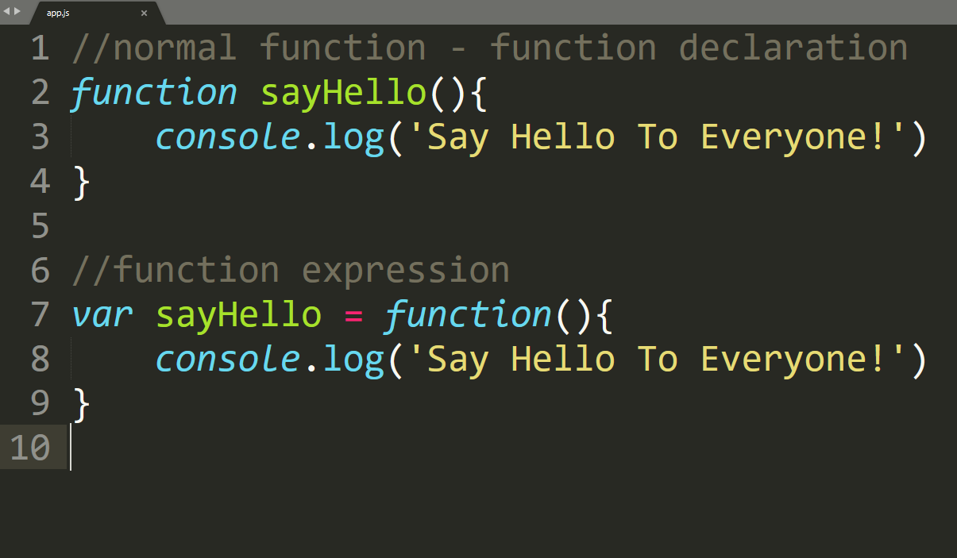
Function Declarations vs.
Function Expressions

Slide 29





KEYWORDS 'REQUIRE'
& 'MODULE'

Slide 30
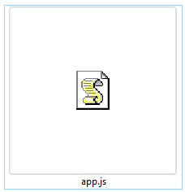
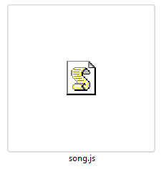
Create two ﬁles `app.js` and `song.js`. you can create your ﬁles as your desired name.

Slide 31


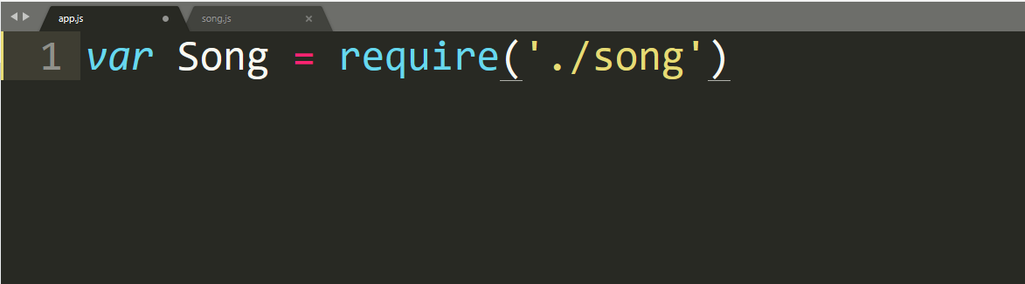
Now you can call the sing ﬁle by require it and store it in a variable

Slide 32
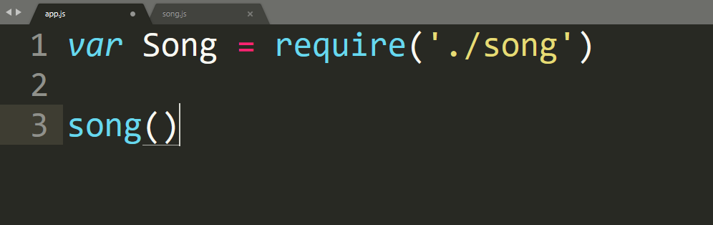
Now you can call the function from the
`app.js` ﬁle

Slide 33


MORE 'MODULE'

Slide 34
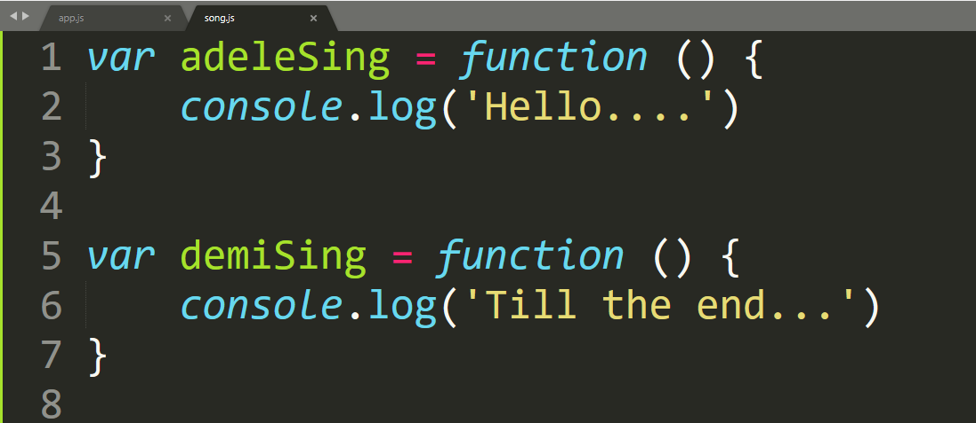
We are using ﬁles as last posts. Now it can happens that in our `song` folder there are two diﬀerent functions.

Slide 35
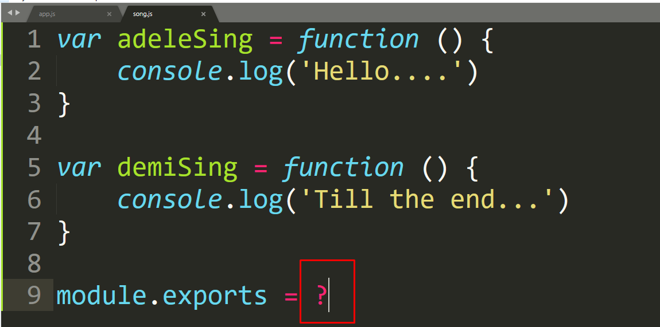
Now how to send this both module, as per we know from last posts we can't send both functions using this module.exports

Slide 36

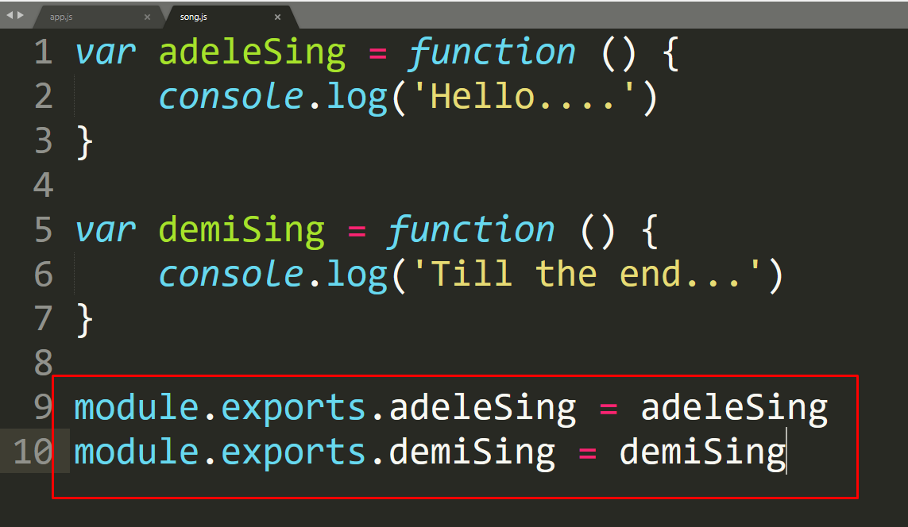
Adding module.exports.VARIABLE_NAME we can send it to other ﬁle

Slide 37



This is not all,
there are some others way you can do it to.
What if you have 100functions in the
same ﬁle are you going to write one by one ?

Slide 38

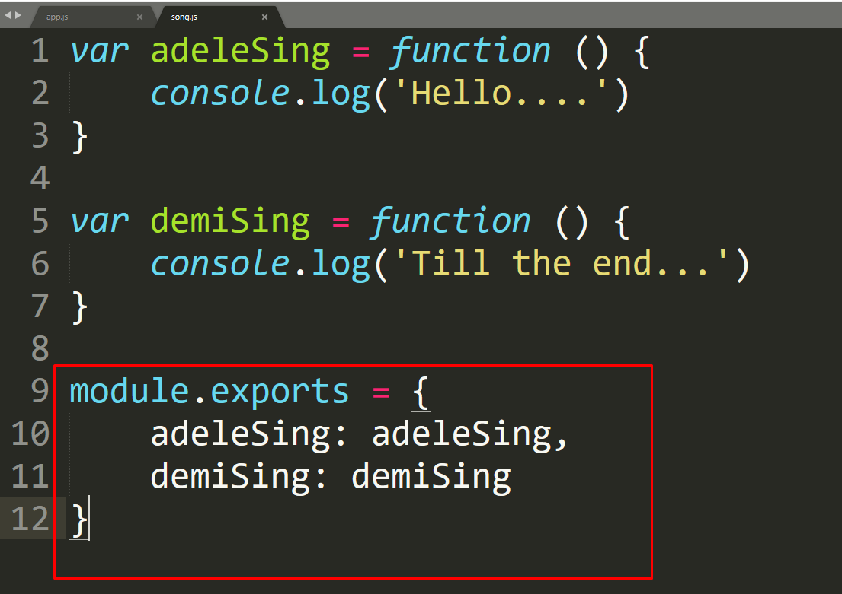
Now we can just use module.exports as a object !
-Example-

Slide 39

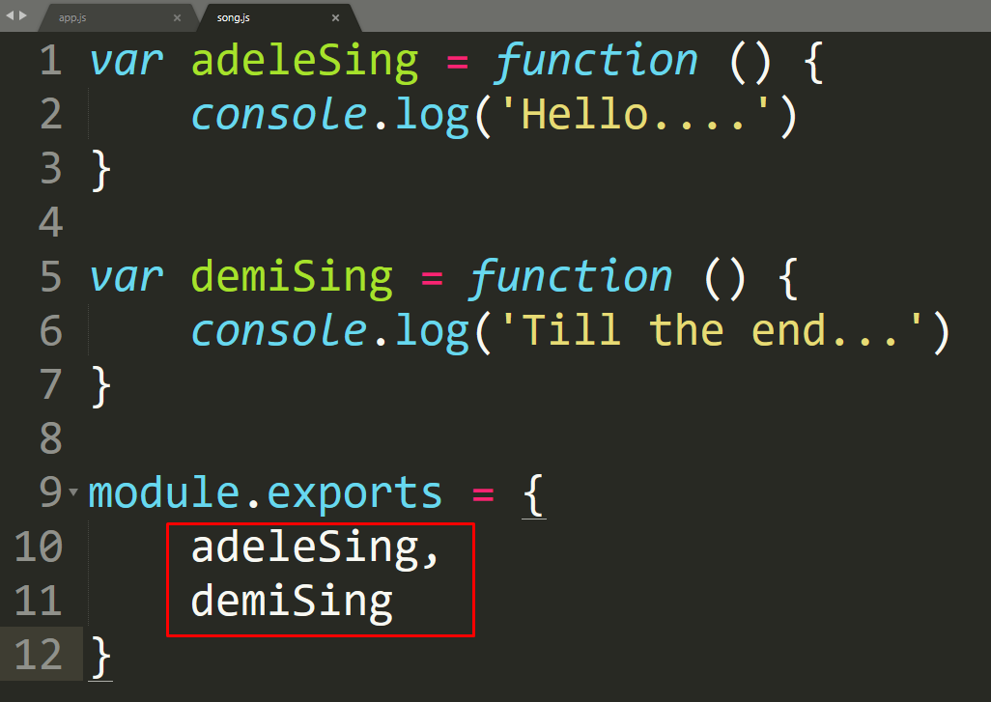
now we can modify code a bit. When
the name are same in es6 version we can write just once.

Slide 40


SO, DO YOU FEEL YOU KNOW A BIT ABOUT
MODULE NOW ?

Slide 41






VAR
CONST
LET

Slide 42

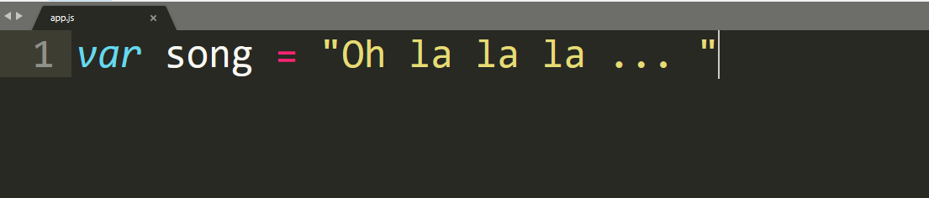
Before es6 `VAR` was the King. We used var in everywhere
we wants to declare a variable

Slide 43

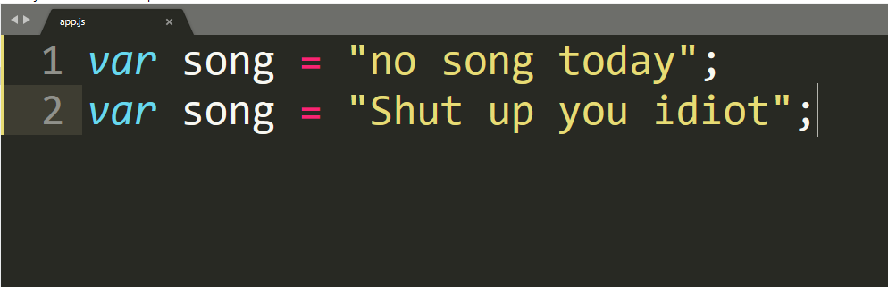
`var` variables can be
re-declared and updated

Slide 44


`Now we divide var with
two diﬀerent types one CONST & other LET

Slide 45





CONST is declared for those value which will not changed anytime!
Or will not be updated at any point

Slide 46
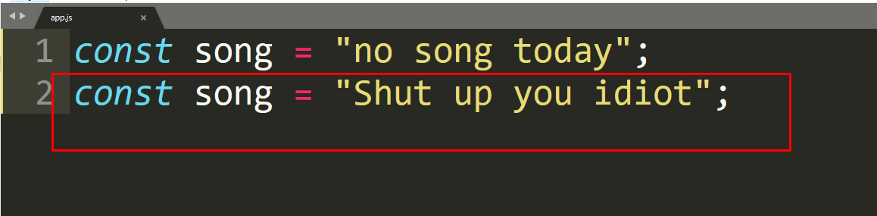
`CONST` cannot be updated or re-declared
this will give a error you can't run code

Slide 47

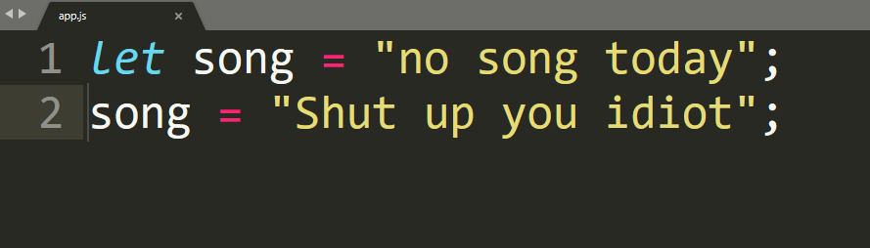


We use LET when their is a change of updating the variable

Slide 48

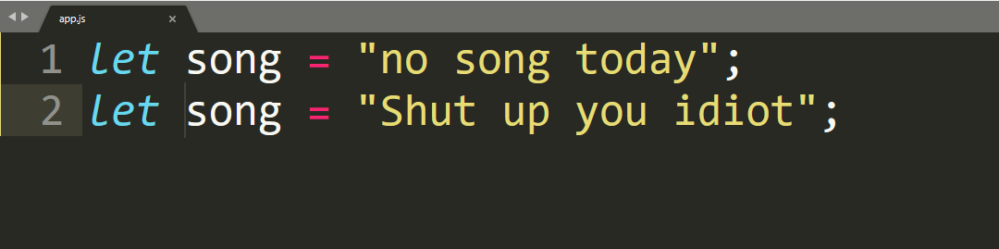


LET can be updated but not re-declared.
this will give a error you can't run code

Slide 49

So in es6 we use LET & CONST
not Var!

Slide 50



MASTERING
EVENTs

Slide 51
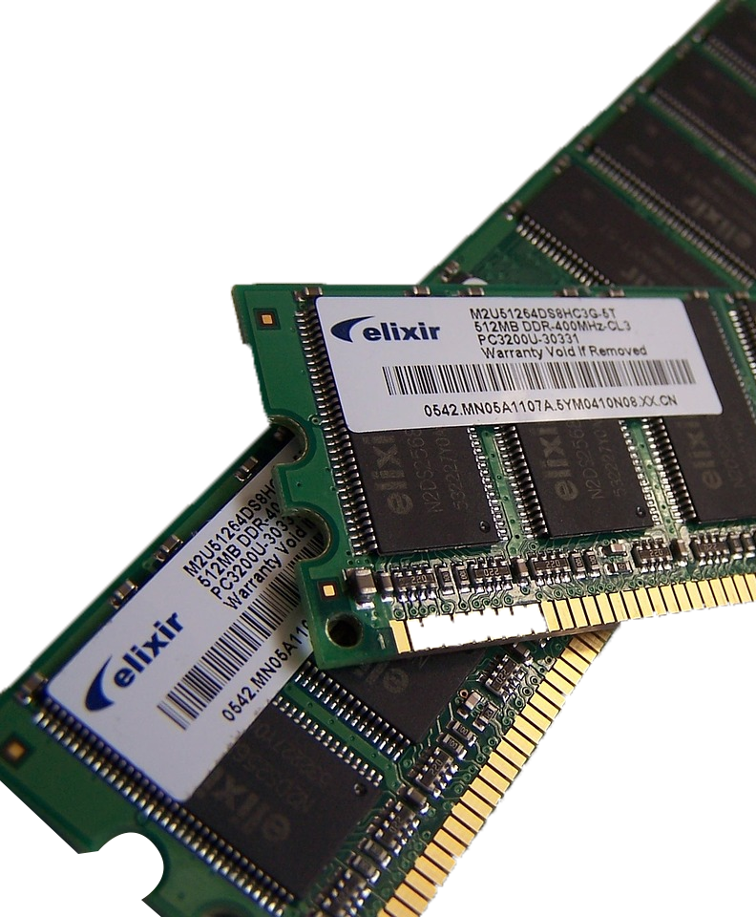
File
READ & WRITE
using node api fs

Slide 52
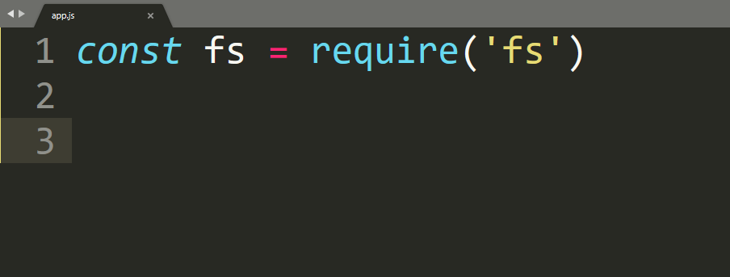


Now,
ﬁrst we need to require the fs
and store it on a const by writing
`const fs = require('fs')`

Slide 53
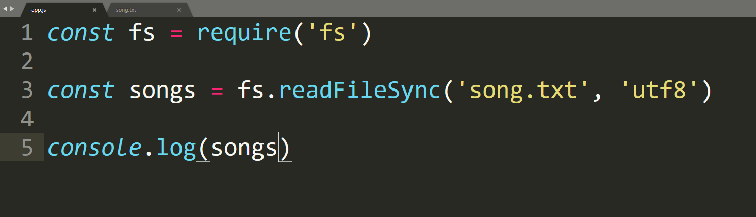

I am using a `song.txt` ﬁle on same folder and read ﬁle text using `readFileSync` and console log it

Slide 54

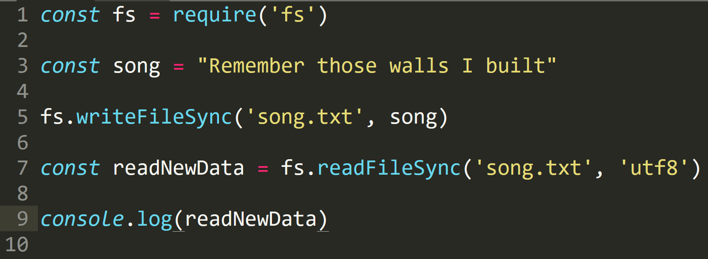

Using fs.writeFileSync (path, dataForWrite) we can write in the ﬁle, what we need to write.

Slide 55
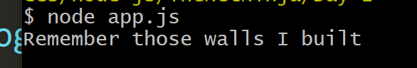

After write, we need to read the data so that we can see if we write in ﬁle properly

Slide 56


Creating
and
Deleting Folders

Slide 57

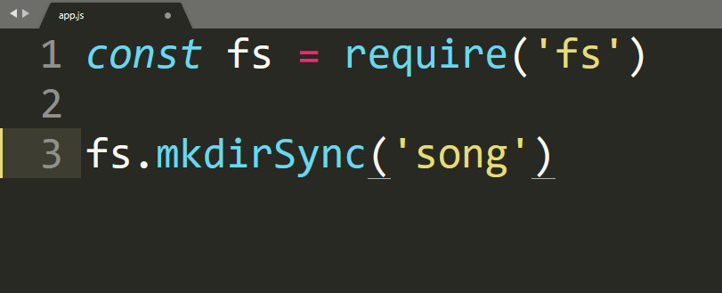
I'm creating a new folder called
`song` by writing fs.mkdirSync

Slide 58
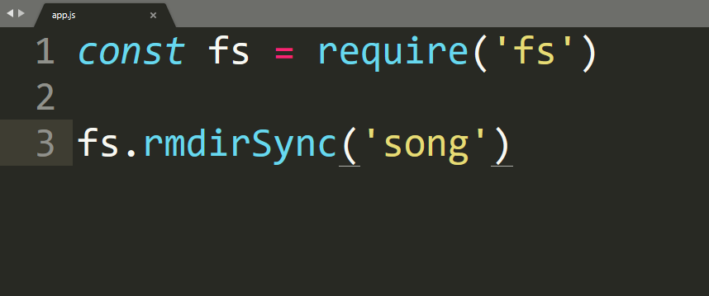
We can delete dir by fs.rmdirSync(path) so we'll try it

Slide 59


Creating OWN SERVER

Slide 60

Client make a request to the server and server provide the ﬁles using socket.
So we are going to learn about how to make our own server using node today!

Slide 61
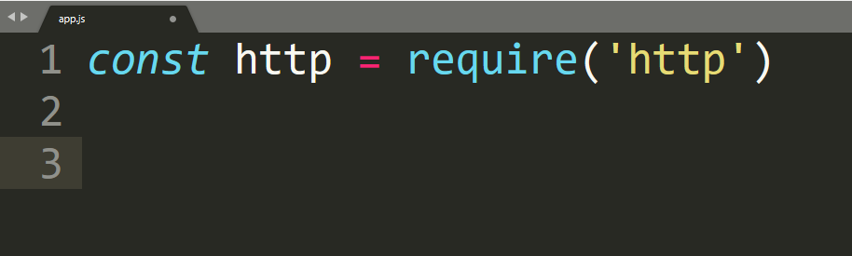
First we are going to require http and store it to http variable using
`const http = require('http')`

Slide 62


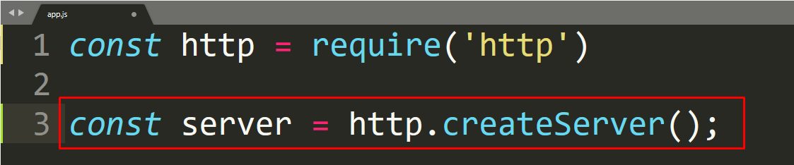


We can just start our server using
`const server = http.createServer()` but there are some more work to do.

Slide 63
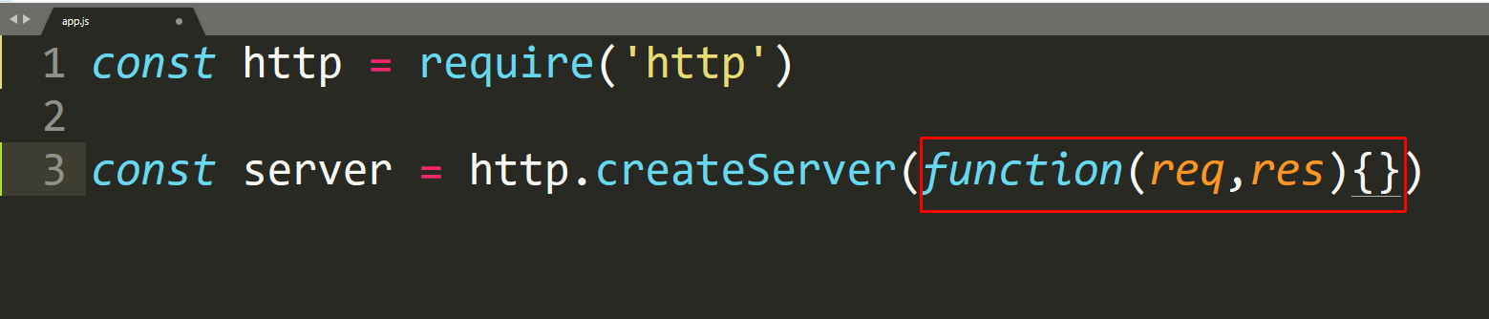
We need to write a function inside the createServer() so that we can get the request and response according about it

Slide 64
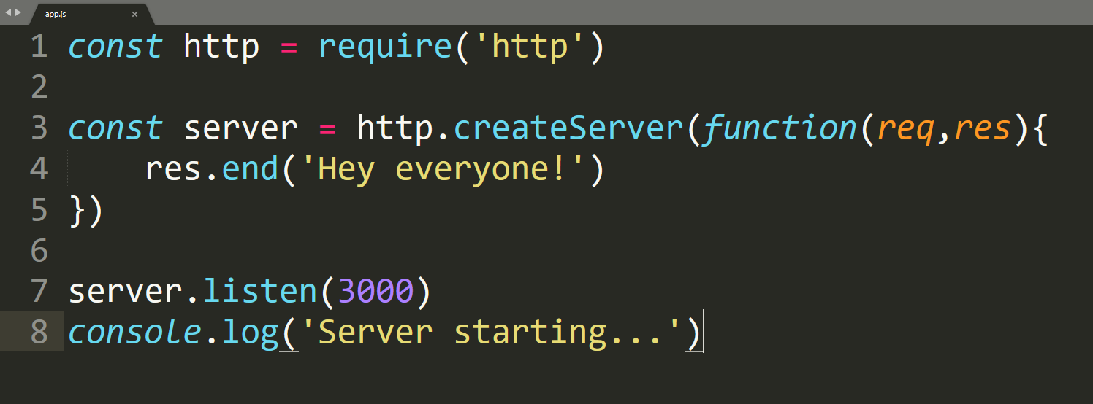
now we can send data to request using `res.end('Hey everyone!')`
and we need to give a port to listen. In my case I'm using 3000.

Slide 65


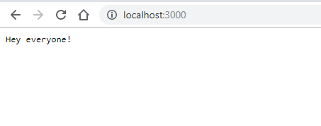
and ﬁnally go to localhost:3000 and you can see the result

Slide 66


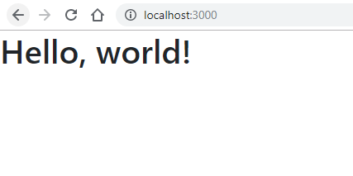

See the result

Slide 67



Sending JSON
to Client

Slide 68

Do you know we can send JSON object to the client side ?
And we mostly use JSON data to pass client side.

Slide 69
We need to create a server first.
You can see

Slide 70


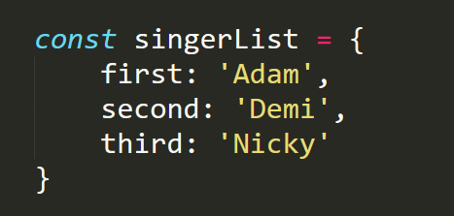

Now we can create an JSON object

Slide 71

Now change the Content-Type

Slide 72


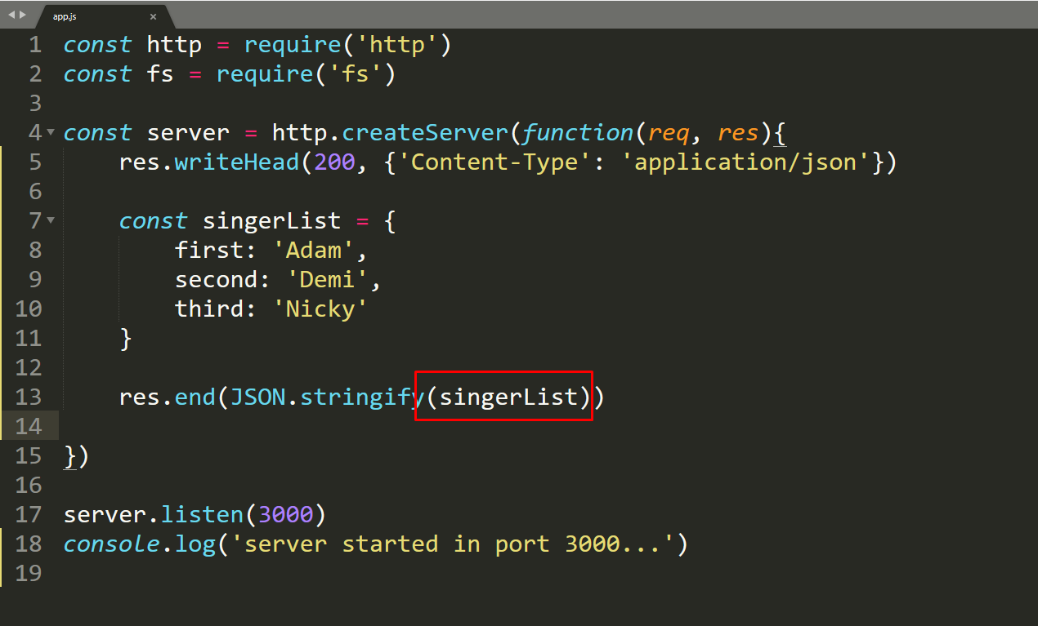
We can send the data to frontend now using `res.end(JSONObject)`

Slide 73

`JSON.stringify()` A common use of JSON is to exchange data to/from a web server.

Slide 74

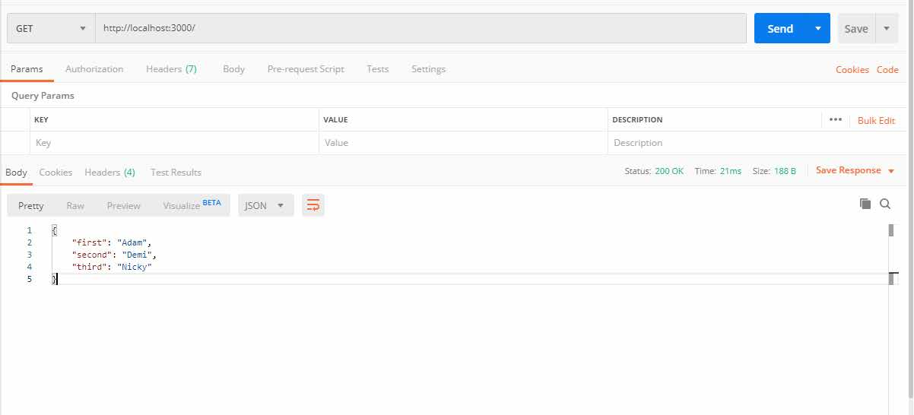


Called server using postman -

Slide 75


NODEMON

Slide 76
Up until now we've faced an issue.
Did you noticed it already ?

Slide 77
Everytime we change some part of our code
and we had to re-run again right ?
Isn't it tiring ?

Slide 78
We can easily end this re-run process by using a package call nodemon.
So how to use this nodemon ?

Slide 79
`npm install -g nodemon` will installed nodemon, but what is the `-g` ?
Up until now we never saw something like this right ?
`-g` means global.
Installing globally means we use this package from any npm projects.

Slide 80
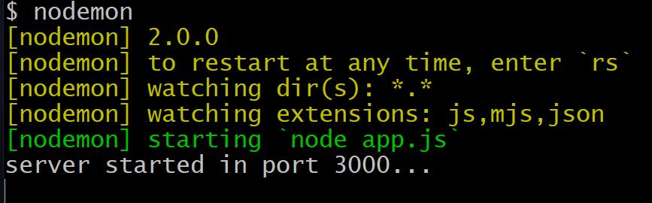
There is two way we can now use the nodemon. Easiest one is - just simply write nodemon in the console and it will start the server.
Nodemon is smart enough to point app.js when you just call it using nodemon, you can write nodemon app.js too.

Slide 81
Now we can change anything and save it,
nodemon will automatically restart the server for us
with new changes.
SO ARE YOU GOING TO USE NODEMON ?

Slide 82

Routing (Basic)

Slide 83
We've already created basic server before so we already know how to start a server and get reponse.
But how we can go on a specific
route ?

Slide 84
Solution is not that hard actually.
We can check req.url first, which url client is asking for, then we can provide
the data basis on that.

Slide 85
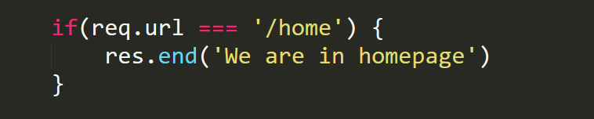
To make the routing,
first we can check the request url using if and send some reponse based on that.

Slide 86
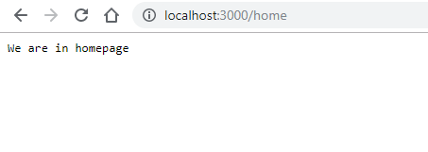
Run it using `node app.js` and check in browser
http://localhost:3000/home

Slide 87
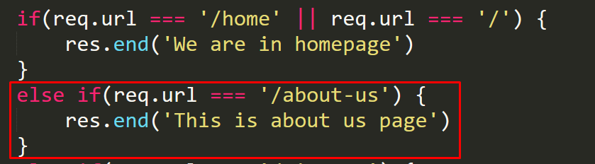
Now we can easily add new page. ex- about us page

Slide 88
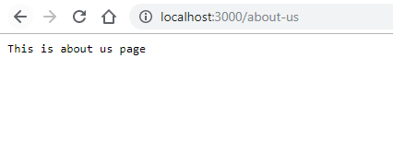
Stop the server and re-run again using `node app.js`

Slide 89
We can add more pages like this.
But what if someone request a url we didn't listed ?

Slide 90
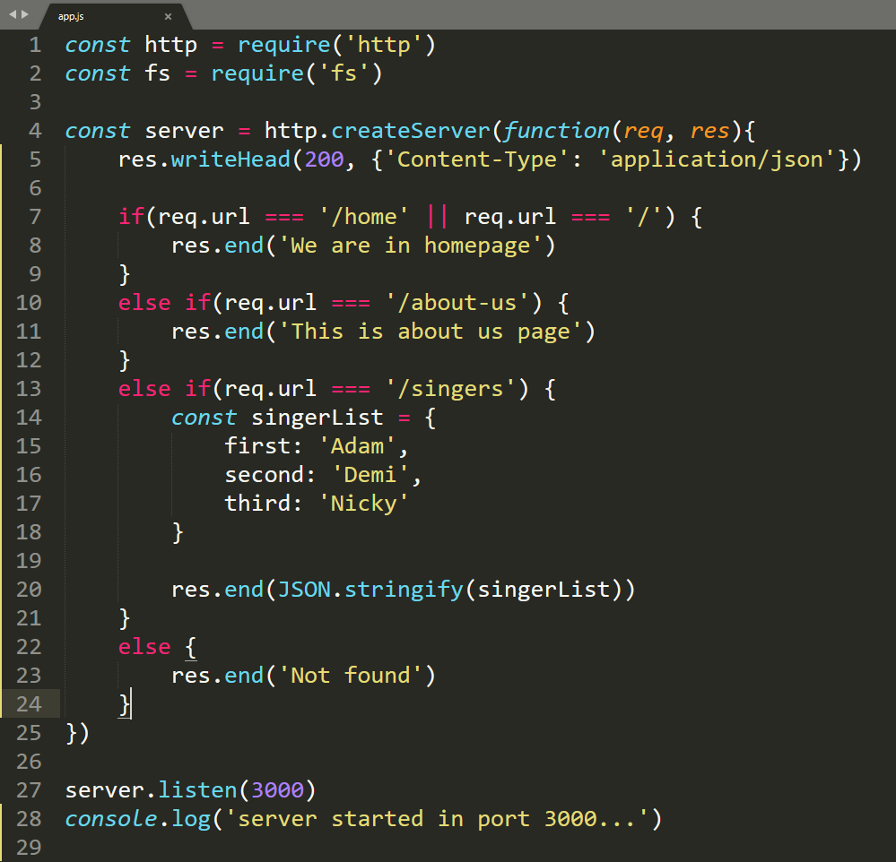
Solution is pretty simple just add a else for that and send
tell them not found.

Slide 91
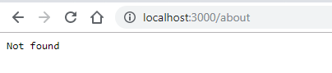
Finally you can check using the wrong url.
“SO CAN YOU WRITE ROUTES NOW ?”

